Slide 1

GENDER AND CLIMATE
Presentation by Astro Visionaries

Slide 2
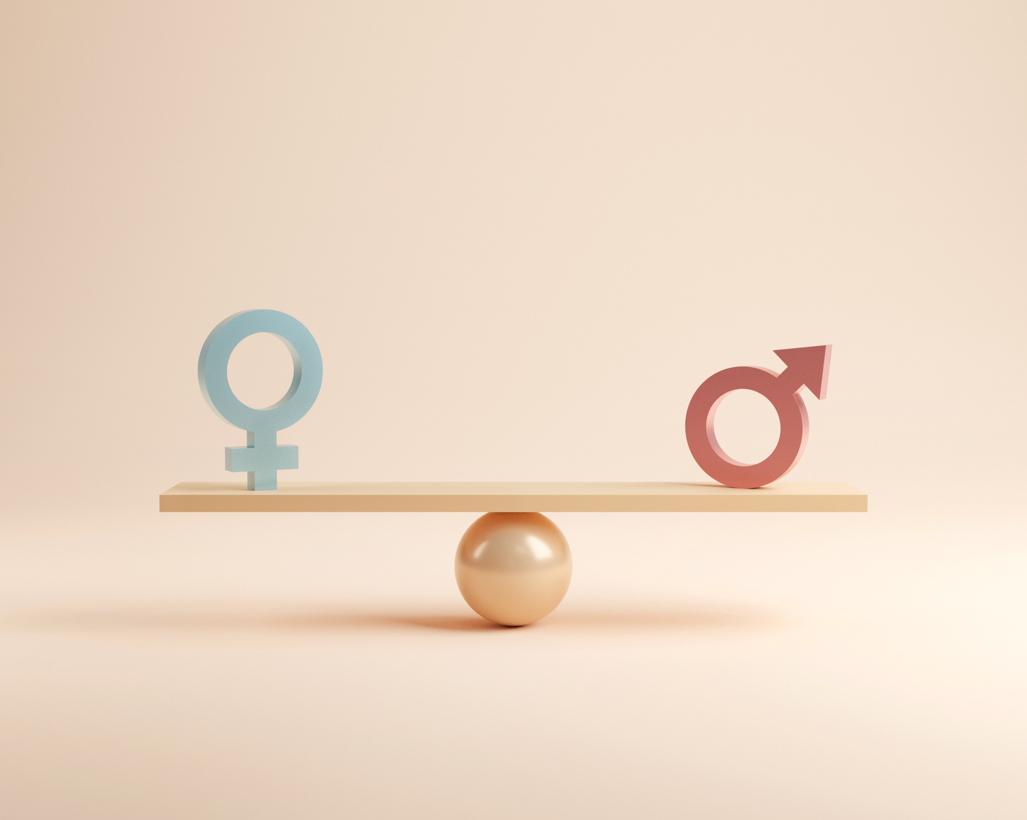
Impact Overview
General Impact on Gender Equality
Climate change slightly impacts gender equality, Women, especially in developing countries, are often more vulnerable to climate-related disasters.
We observed the HDI (Human Development Index), GDI (Gender Development Index) to be lower for lower developed countries, like those in South Asia.
But there is no significant impact of climate changes to GDI, or HDI.

Slide 3
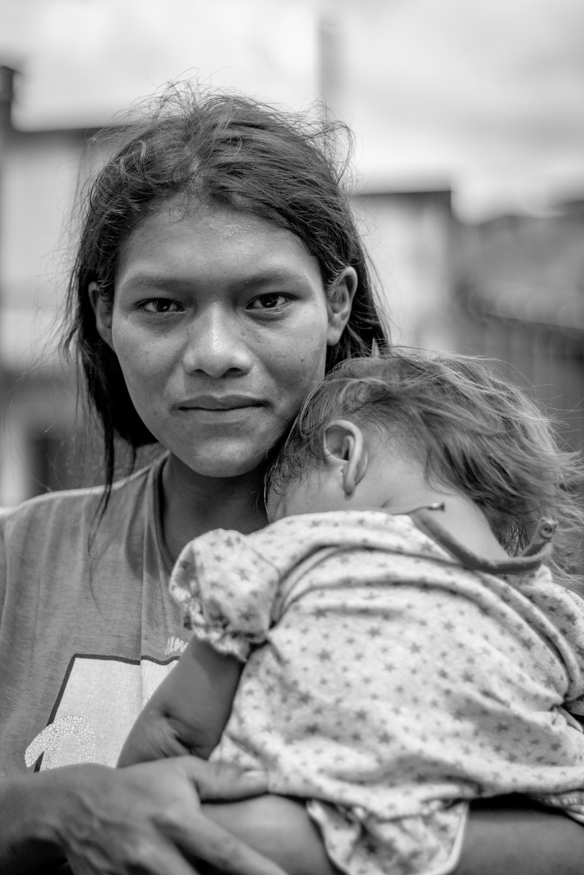
Overview of Gender Equality
Gender Equality and Human Development
Gender equality plays a crucial role in driving sustainable development and economic growth.
Countries with higher Gender Development Index (GDI) scores show better progress in education, healthcare, and economic participation for women, which benefits society as a whole.
The Gender Inequality Index (GII) highlights areas where disparities in health, empowerment, and labor market participation still exist, especially in regions affected by socio-economic challenges and climate vulnerability.
We have used HDI, GDI, GII, and Life Expectancy to explain Gender Equality to our model.

Slide 4

Global Examples
Support Initiatives in Kenya
Gender-Responsive Climate Funds
Community Resilience in Bangladesh
Kenya has implemented programs to support women farmers in adapting to climate change by providing training and resources. These initiatives have improved crop yields and economic stability while promoting gender equality.
Many countries are developing climate funds that prioritize gender-responsive projects, ensuring women's involvement in their design and implementation. These funds aim to tackle the unique challenges women face with climate change.
In Bangladesh, community-led approaches have empowered women to take part in disaster risk reduction efforts. Programs that involve women in planning and response strategies have resulted in improved community resilience to climate impacts.

Slide 5
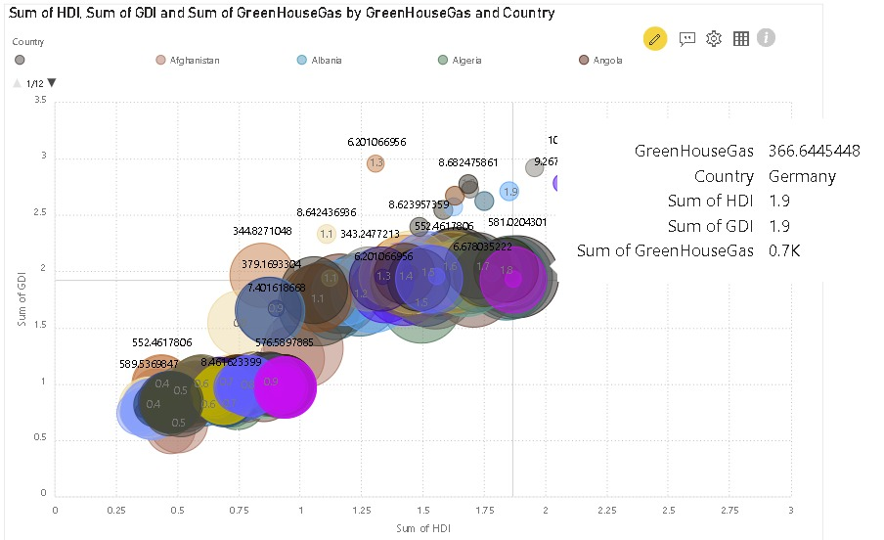
Intersection of Human Development, Gender Equality, and Greenhouse Gas Emissions
Countries like Germany have moderate greenhouse gas emissions (0.7K on the chart) with balanced HDI and GDI scores (both at 1.9), indicating high human development and gender equality.
In contrast, countries with larger bubbles but lower HDI and GDI (like Angola or Afghanistan) may have significant emissions but face challenges in human development and gender equality.
This chart highlights the intersections between development, gender inequality, and environmental impact, offering insights for policies promoting sustainable growth.

Slide 6
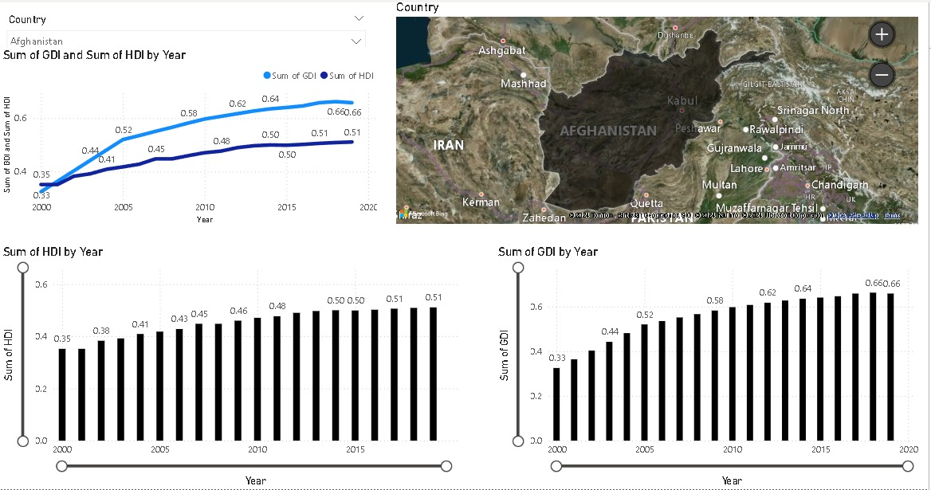
Human Development and Gender Equality in Afghanistan Over Time
The charts reveal a gradual increase in both indices, indicating steady improvements in education, health, and income equality between men and women.
By 2020, Afghanistan’s GDI reached 0.66, while its HDI remained stable at 0.51, showing slight but positive advancements in gender equality.
Despite these gains, the relatively low levels of both indices reflect the significant development and gender-related challenges still faced by the country. The map highlights Afghanistan’s geopolitical position, which often influences its development and socio-economic factors.

Slide 7

Future Approach
NASA Satellite Data: Utilize NASA’s Earth observation imagery and environmental data to monitor climate change effects such as deforestation and CO2 emissions, integrating it with gender-related analyses.
Advanced Data Analysis: Incorporate more climate and gender-disaggregated data to better understand the impacts on vulnerable populations.
Modeling and Simulation: Utilize machine learning techniques to predict long-term effects of gender-responsive climate policies.
Global Collaboration: Engage with governments and NGOs to integrate these findings into policy-making for more effective and inclusive climate action.

